Slide 1

A Sustainable Future for Nantucket
Will Horyn and Alex Perkins
August 11, 2011

Slide 2
Sustainability
Youth Summit delegates agreed on a definition of sustainable development as “development that meets the needs of the present world without compromising future generations.”
Negative effects of C02:
  Stress on plants and animals
  Melting polar caps
  Acid rain
  The ultimate deterioration of our planet

Slide 3

Youth Leadership Summit for Sustainable Development
Themes
• Sustainable Agriculture
• Sustainable Business
• Sustainable Energy
• Sustainable Housing
• Sustainable Islands
• Sustainable Living
Each made presentations:
What is my dream for my life, my island, and my world?
What is your dream?

Slide 4
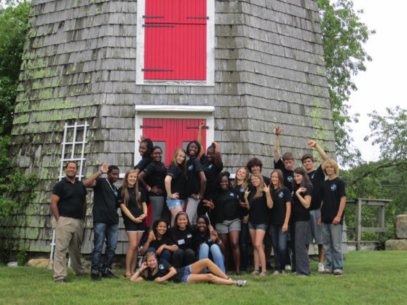
Island Youth Delegates
From
  Hawaii
  Nantucket
  Martha’s Vineyard
  Vieques
  Virgin Gorda
  Youth Summit Faculty
  from book: Stone Soup for the World: Life-Changing Stories of Everyday Heroes
  • California
  • Martha’s Vineyard

Slide 5
Stone Soup Leadership Institute
The Institute’s mission is to develop educational tools, trainings, initiatives to prepare young and emerging leaders to build a more sustainable world.
The Institute has organized eight youth community initiatives, first on Martha’s Vineyard, then in inner cities and two Caribbean islands and convened 7 Youth Leadership Summits in two countries, preparing young people to envision their future and empowering them to become leaders of a more sustainable world.
4-year demonstration project used book/educational curriculum and faculty who worked side-by-side young people to develop their vision, projects and initiatives to build a sustainable island.
The Vieques Youth Leadership Initiative college students created 2020 Report on Sustainable Development as a roadmap for their island’s future. Presented to community, government and business leaders; at Asian-Pacific Economic Council (APEC) Youth Summit in Peru to inspire youth leaders from 21 countries to create a declaration for world leaders: November 2008.
Founded on Martha’s Vineyard in 1997, the Institute is a 501c3 non-profit organization registered in Massachusetts.

Slide 6
Stone Soup Leadership Institute
In the last century we’ve shown the world how
we can attack and solve perplexing problems with technology.
Imagine if we were to apply that same intellectual power to solving the greatest problems the world faces – poverty, overpopulation, pollution, medical insufficiency, and our dependence on nonrenewable energy resources.
Now is a good time to launch a bold new global initiative.
This could be our version of the putting a man on the moon.
It's time to take action -- and chart the course for our future.
Walter Cronkite

Slide 7
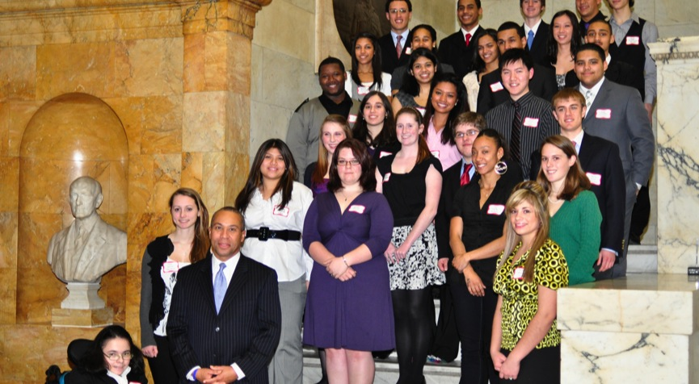
Youth Nomination Process
MVYLI Emma nominated Will; Will nominated Alex

Slide 8
Sustainable Vineyard Tour
A new way of looking at the Islands we live on:
Island Grown Schools
The Farm Institute
Island Alpaca
Eliakim's Way
Grey Barn Farm
Island Cohousing
Martha’s Vineyard Shellfish Hatchery
Native Earth Teaching Farm

Slide 9
Sustainable Building:
Island Cohousing
Stimulates sustainable living
Isolated parking
Community Garden
Community Pond
Builds community bonds
Fosters local growing
Provides positive living example
Modeled on a Danish housing concept developed in the 1970s, the sixteen homes at Island Cohousing (ICoho) are tightly clustered in a manner that encourages social interaction, provides a safe and supportive environment for children, maximizes open space: 85% of the land is undeveloped in perpetuity.

Slide 10
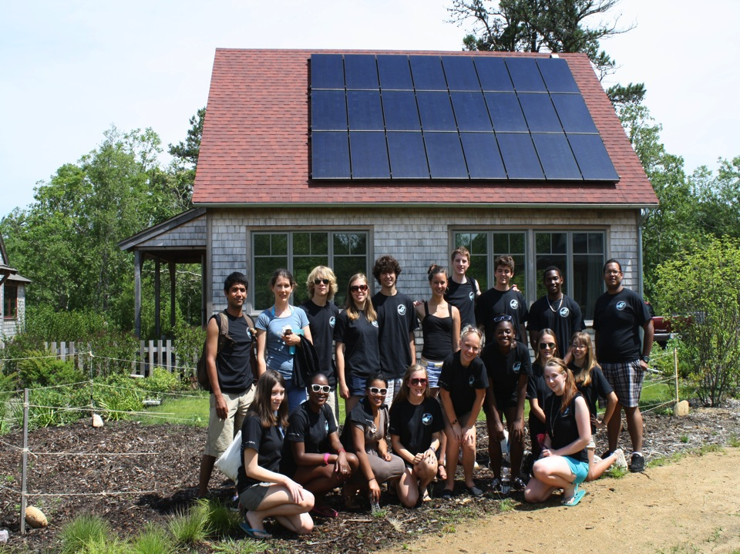
Sustainable Building
High Energy Performance Affordable Housing
Eliakim’s Way Community

Slide 11
Sustainable Agriculture
Over 40 farms on Martha’s Vineyard: provide 5% food
Island Grown Schools
Island Grown Initiative: local butchery in near future
The FARM Institute: working teaching farm; fosters youth- community involvement
Portable and local chicken processor

Slide 12
Sustainable Business
MVYLI Business Internship presentation
Promote Local Entrepreneurship
MVYLI Job Shadow Day: matching/mentoring youth
Internships for Green Jobs
Local In-Kind Donations: air, cars, gas, food, lodging, etc.
Corporate Social Responsibility:
Honest Tea, Newman’s Own

Slide 13
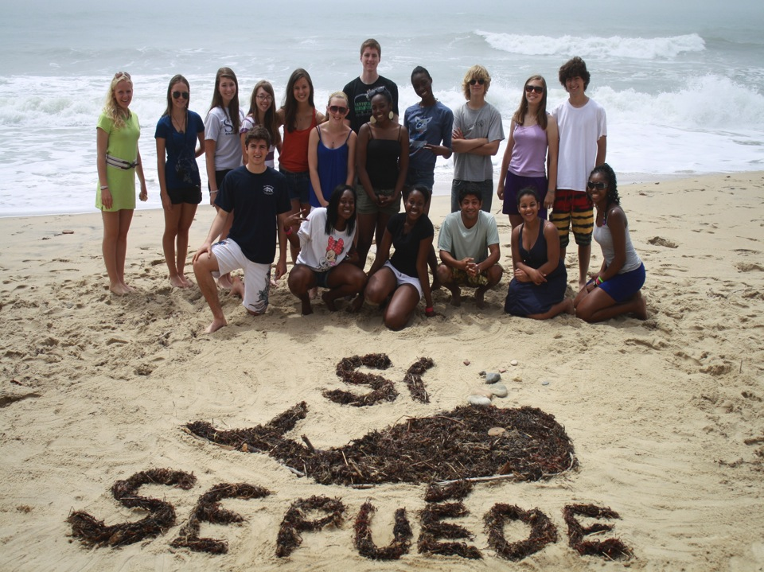
Youth Leadership

Slide 14
Sustainable Island Vision
Martha’s Vineyard Youth Leadership Initiative in partnership with Martha’s Vineyard Commission
(The Commission’s 5 year project to develop a vision for 2050 – but forgot to include youth – so MVYLI youth developed a strategy)
Their stated goal was to identify those areas that sustain, promote and protect their island’s culture and way of life – and to protect, promote and improve the natural environment, allowing for ecological growth and biotic diversity without polluting water, air or soil.

Slide 15
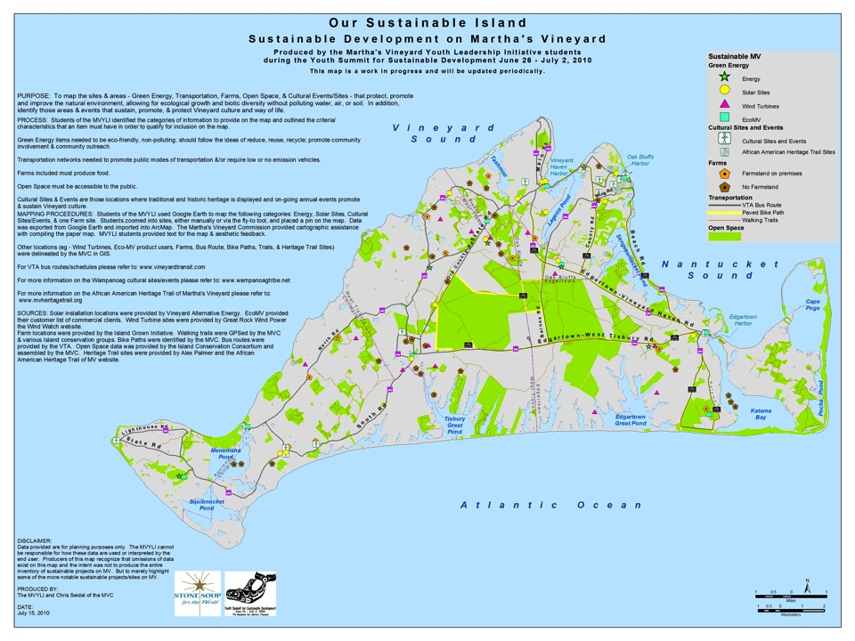

Slide 16
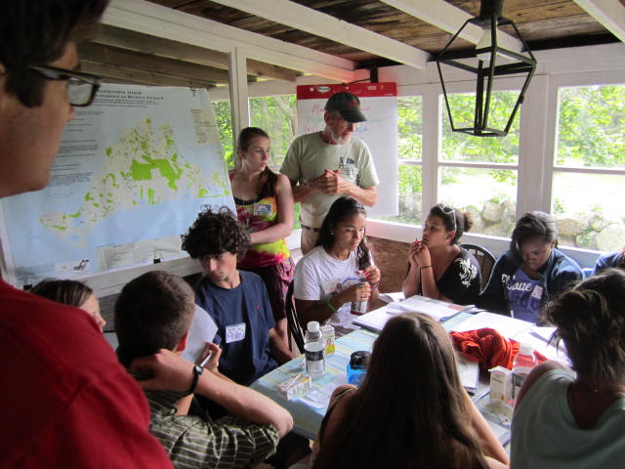

Slide 17
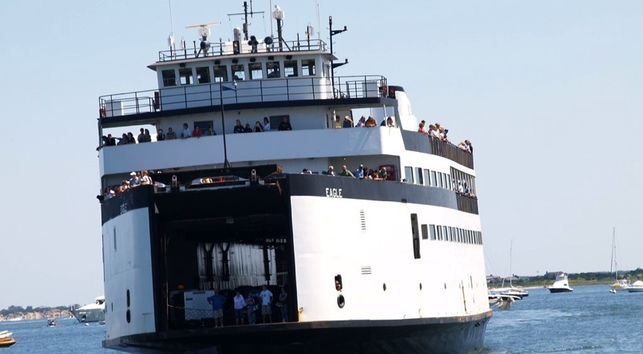
Sustainable Islands
Learning & Collaboration

Slide 18
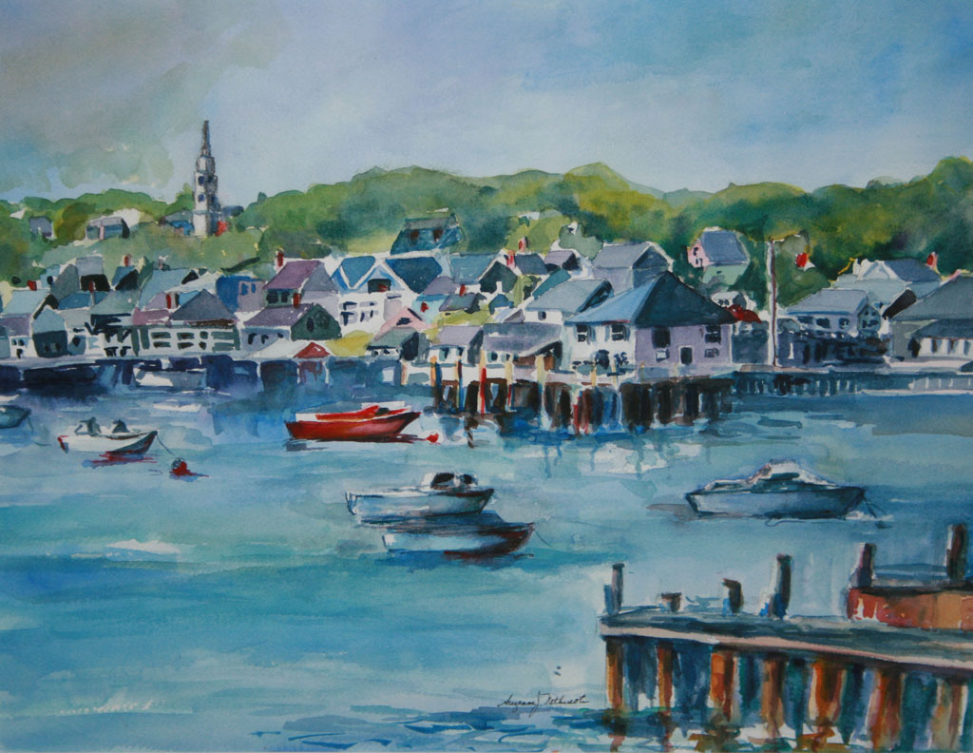
Our Island

Slide 19
Green Community
Five Criteria
  Implement alternative energy source or research facility
  Approval within one year
  Assess and reduce municipal energy consumption by 20% within five years
  Fuel efficient municipal vehicles
  Minimize life cycle cost of new construction

Slide 20
Green Community Benefits
Federal/State bonuses and grant money
Substantial monetary savings
Reduction of negative impact on environment
Unity & collaboration to create a clean world!

Slide 21

Sustainable Energy
Wind Turbines
  NHS Turbine Projected Savings: 20-30%
Tidal Turbines
Photovoltaics
Reduces dependence on foreign oil
National Grid is currently limiting Nantucket’s alternative energy output; inhibits future projects
  Nantucket ≤ 780 kW
  MA cities/towns ≤ 10,000 kW

Slide 22

Energy Efficiency
Low consumption bulbs
  Each individual bulb will save approximately $16 each year as well as 50 kg of CO2.
High efficiency appliances
  Energy expenses can be reduced by 25% or more.
Effective insulation
  Heating/Cooling account for 50-70% of the energy used in an average household.
Heat Maximization
  10% of your heating bill in the winter can be saved by installing a ceiling fan which circulates warm air from ceiling to floor.

Slide 23
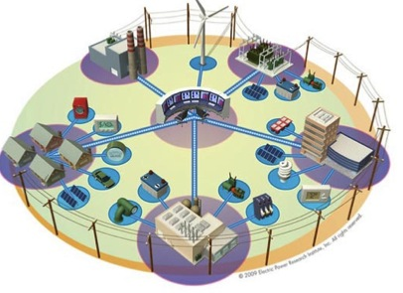
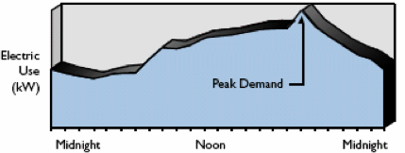
Smart Grid Technology

Slide 24
HVAC Systems on Nantucket
Heat, Ventilation, and Air Conditioning
Upgrading HVAC systems can yield up to a 30% tax credit
Currently investigating and updating boiler systems in Town Buildings

Slide 25
PROGRESS since Youth Summit
Nantucket youth delegates Will Horyn and Alex Perkins invited by new Nantucket Energy Coordinator Lauren Sinatra to assist with Energy Audit of Nantucket public buildings.

Slide 26
Sustainable Agriculture on Nantucket
Sustainable Nantucket
Soil conservation
Maximize water usage
  Utilizing “gray” water to irrigate crops will reduce wasted water
Lack of local butchery on Nantucket

Slide 27
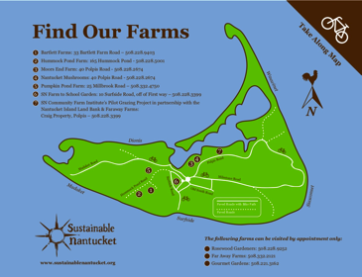
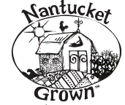
Sustainable Nantucket
Community Farm
Gleaning
Internships
Farmer’s/Artisan’s Market
Nantucket Grown Publication
School Garden

Slide 28
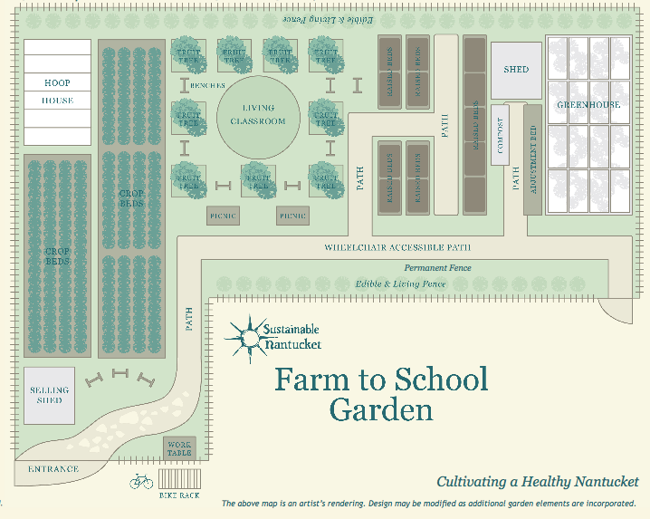

Slide 29
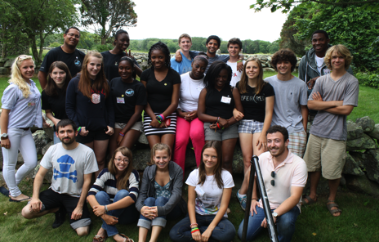
Sustainable Business
“Green Pages” in phone book
Economic “Reinfusion”
Fees and Benefits
Our goal: Ecology, Equity & Economy

Slide 30
Investing in Sustainable Business
Benefits
Saving energy and money
  Improved employee productivity
  Reduced operational and maintenance costs
  Increased customer comfort
  Increased asset value
  Enhanced public image
  Improved quality of life

Slide 31
Sustainable Housing
Buildings account for 42% of the nation’s energy consumption
Investment that pays off!
  Minimal initial expense =
  ONLY 7% greater than “typical” housing costs
  Reduced maintenance costs
Sustainable houses consume 80% less energy
Saves money long-term and reduces carbon footprint
2/3 of the US economy is consumerism;
Efficient housing saves money, thus catalyzing the increase in consumerism, jobs, and the strength of the economy
Is necessary as a role model
There are sustainable builders on Nantucket: Green Pages

Slide 32
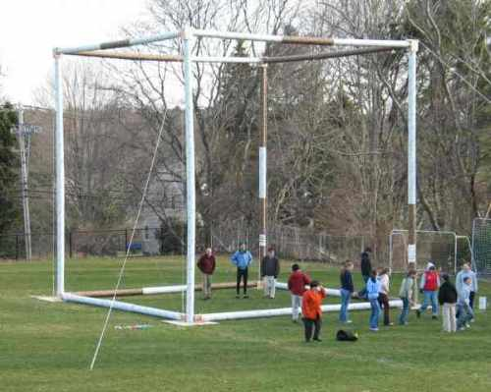
The average four person household in the US produces 5 tons of CO2 annually
One Ton of C02

Slide 33
Innovative Strategies for Community Involvement
Reduce, Renew, Recycle
Green Nantucket: one day/week
Service projects: green
Scholarships: green education
Internships: green jobs
Collaboration
Working together = Unity towards positive goal

Slide 34
School Education
Introduce sustainable curricula in school system
“Green” School to Career
Integrate environmental education to all classes
Green community service projects
Cradle to Cradle – recommend as required reading?
Offer incentives for youth to support sustainability(nominate youth delegates to 8th Annual Youth Summit)

Slide 35
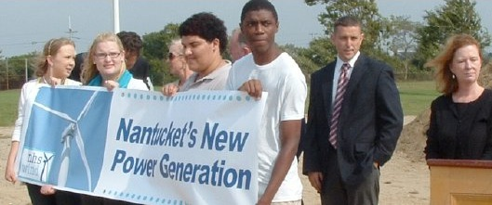
Sustainable Youth Council
Recommend: two members of Students for Sustainability: elected democratically
Representatives to meetings/conference with town officials/third party participants and represent SFS
Give voice to youth: e.g. Martha’s Vineyard Plan

Slide 36
Nantucket Youth Leadership Initiative
Collaborate and provide technical assistance and support for Students for Sustainability, Sustainable Nantucket, Energy Coordinator., Selectmen, Nantucket Chamber of Commerce and others.
The Stone Soup Leadership Institute provides training and technical assistance:
Nantucket youth envision, develop and present their vision for their life, their island and their world.
Youth receive educational tools and training to prepare them to address key issues and develop projects.
Youth are inspired/learn from other youth who’ve changed their lives, their islands, world;
Youth are exposed to innovative sustainable development models; develop action plans to implement their vision; prepare presentations; develop strategies to engage other youth and their community leaders; troubleshoot challenges, develop public-private partnerships to invest in sustainable development.
Youth learn to make effective presentations about their experiences and projects and are featured YouTube;
Youth are empowered to be representatives of issues and projects affecting their islands;
Creates a win-win strategy that, by design, teaches collaboration with other non-profit organizations.
Builds coalition of youth, business, organizations working to build a more sustainable future.
Encourages coordination, collaboration and communication with education and environment community.
The Institute’s Global Technology Initiative connects island youth working on sustainable development projects in their communities – develops best practices; increase support.

Slide 37
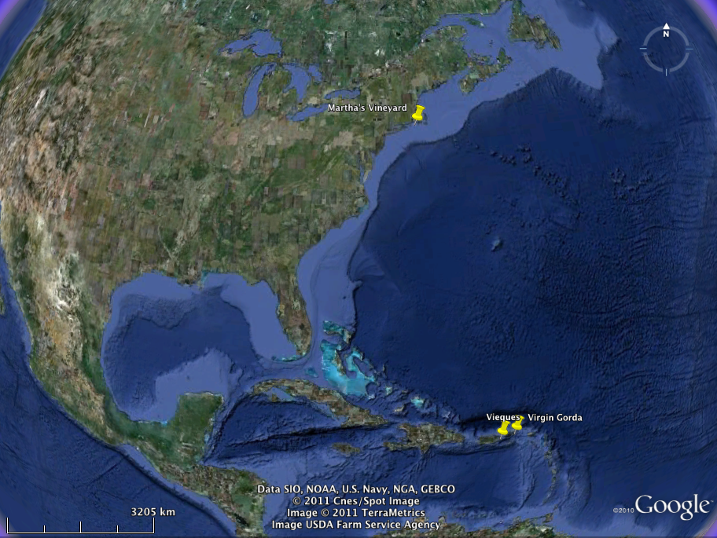
Youth Leadership Initiatives

Slide 38
Ways You Can Get Involved
Sign up tonight to be available to support us and Students for Sustainability!
Be environmentally conscious every day in every aspect your life.
Spread knowledge and raise awareness about the fragility of the environment.
Participate in cleanup teams and green related activities.
Support local sustainable initiatives and businesses.
Mentor/support young people to become leaders of our island!

Slide 39
Recommendations for the Future
Expand Students for Sustainability
Invest and train growing youth involvement.
Greater focus/awareness regarding the environment throughout school and community
Employ sustainable business practices consistently.
Sustainable Youth Council: effective and operational
Make Nantucket a designated Green Community.
Create 2020 Nantucket Sustainable Development Plan.

Slide 40
Thank You
For your time and support
Presented by
Will Horyn and Alex Perkins
For more information
www.soup4worldinstitute.com

Slide 41
References & Credits
www.energystar.gov
www.treehugger.com
www.epa.gov
www.carbonfootprint.org
www.sustainablenantucket.org
www.soup4worldinstitute.com

