Slide 1
Rhode Island: Best Practices for Sustainability
Presentation by Brittany Fulgione
14th Youth Leadership Summit for Sustainable Development
Stone Soup Leadership Institute
June 23-29, 2018
Roger Williams University • Bristol, Rhode Island

Slide 2
Rhode Island is a Leader in Sustainability
• First state to sign the UN’s CleanSeas Initiative
• Leader in Marine and Ocean Health
• Implementing projects to mitigate effects of climate change

Slide 3
U.S. Senator Whitehouse
Rhode Island’s Sustainability Leader
• Created RhodyGreen, a Forum to recognize RI’s ‘Green Champions’ in environmental initiatives.
• Calls for ending Plastics Pollutions for 2018 Earth Day
• Started a RI Corp. of the Environmental Defense Fund, aims to mitigate financial burdens of businesses and organizations working to combat climate change.

Slide 4
RI Climate Resilience Action Strategy
September 2017: Governor Gina Raimondo signed an Executive Order appointing A Chief Resilience Officer to:
“Drive climate resilience efforts across the state, both within government and in collaboration with business, academic, and nonprofit partners, with the mission to develop a statewide Climate Resilience Action Strategy”
The Officer’s main goal is to identify projects, policies, legislation, funding - finance opportunities for the state to better prepare and combat climate change

Slide 5
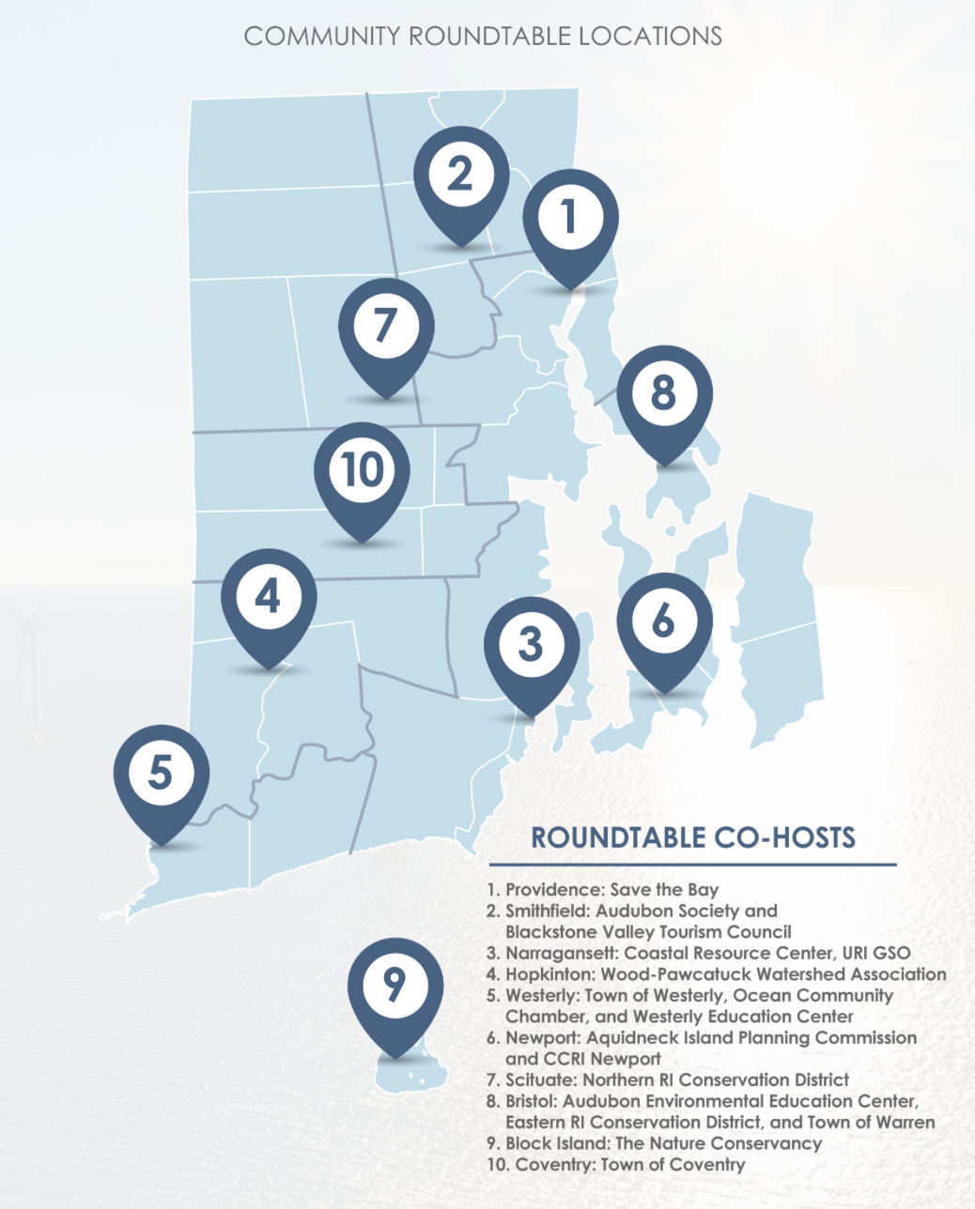
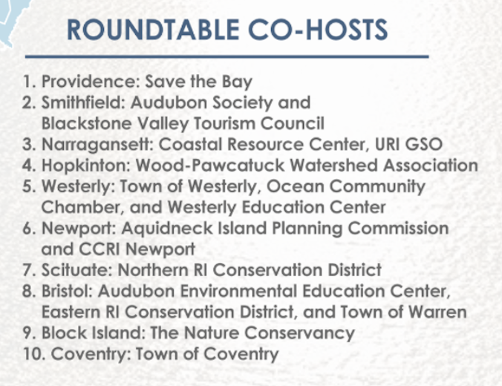
RI Resiliency Roundtable to determine what are key issues; what needs to be done to mitigate climate change.

Slide 6
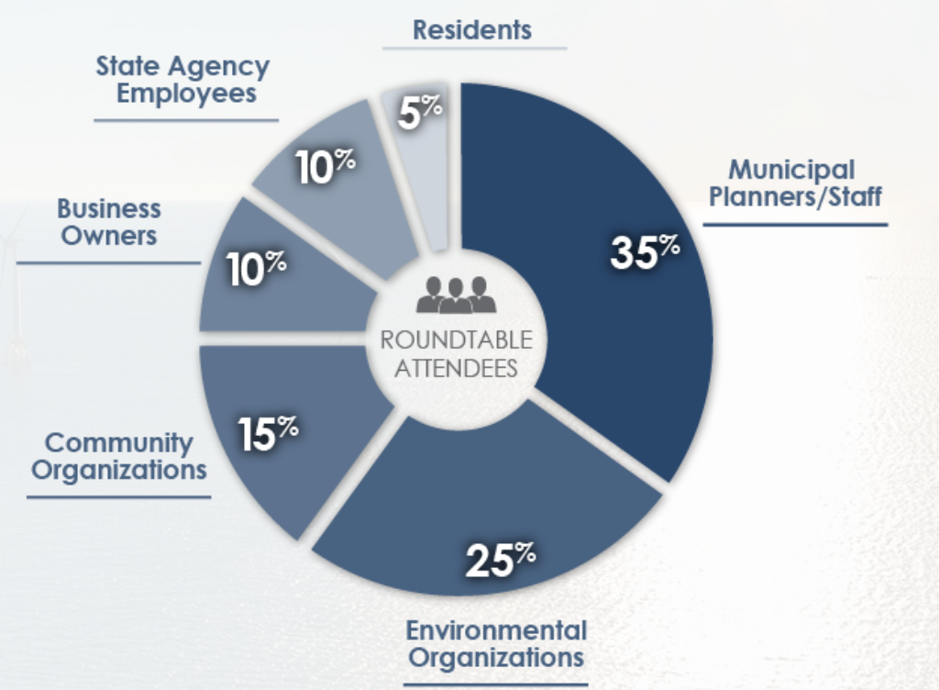
Round Table Constituent Makeup

Slide 7
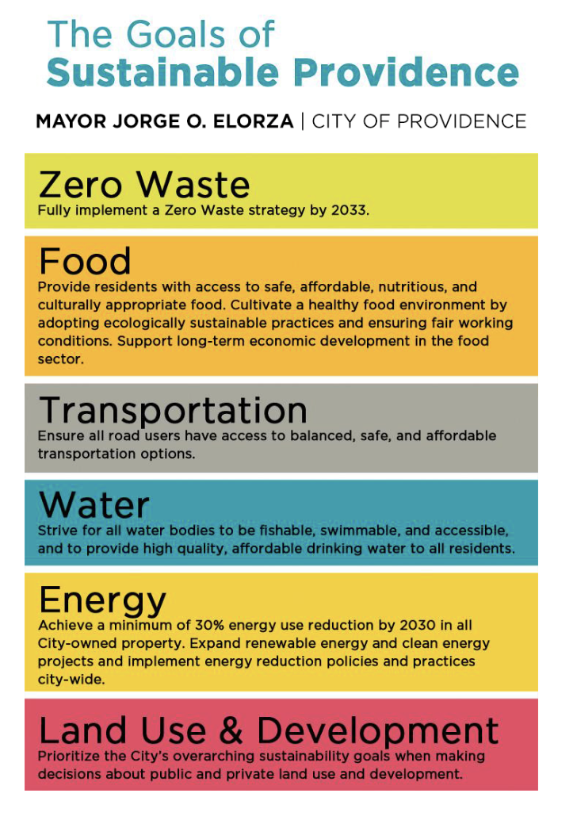
The City of Providence, Environmental Justice League of Rhode Island, and Groundwork Rhode Island are working together to bring a racial equity lens to the City’s sustainability work.
Racial and Environmental Justice Committee (REJC):
1) Identify key concerns, issues, needs for communities of color related to environmental sustainability in Providence;
2) Recommend long-term process and structure for collaboration between communities of color and the Mayor’s Office of Sustainability.

Slide 8
Non Governmental Organizations (NGOs)
Notes:
All work to supplement areas where government involvement has not always been the most prevalent
Work primarily on environmental science, and education of next generations

Slide 9
Non Governmental Organizations (NGOs)
Known for its endless coastlines, Rhode Island has a deep connection with its ocean water.
A long history of extreme pollution has left many bays in the area, including Narragansett Bay, unswimmable, drinkable, fishable.
Many NGOs supplement lacking areas of government initiatives to clean up our oceans & educate the next generation to make conscientious decisions.
Notes:
All work to supplement areas where government involvement has not always been the most prevalent
Work primarily on environmental science, and education of next generations

Slide 10
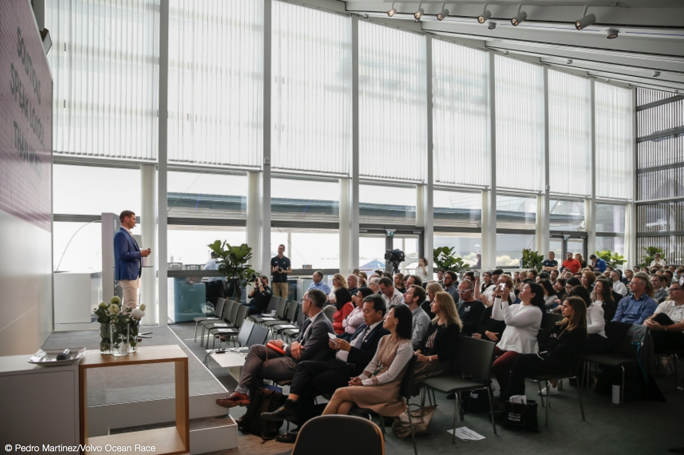
Business Partnerships
Volvo Ocean Summit in May 2018
Intersection between science, industry, and policy makers to commit to clean oceans;
Focusing on microplastic pollution;
RI is the 1st US state to sign the
United Nation’s CleanSeas Campaign
to fight ocean plastic pollution.

Slide 11
Innovative Business Partnerships
SeaAhead
Rhode Island Envirothon
University of Rhode Island: Ocean Engineering
Roger Williams University’s Bon Appetit food recovery/sustainable fisheries
RWU’s Sustainable Shellfish Hatcheries and Farming
Rhode Island Marine Transportation Association
Notes:
More business partnerships but might be too much information for the presentation considering cutting this out

Slide 12
Rhode Island’s Best Practices
Wide Array of Sustainability Initiatives
From Food Waste to Transportation to Energy to Clean Oceans
Intersection between business, government, community organizations and environmental organizations.
Taking action to include the lens of racial equity and equality.

