Slide 1
The TouchStone Leaders Platform Igniting the Human Spirit
www.touchstoneleaders.com

Slide 2
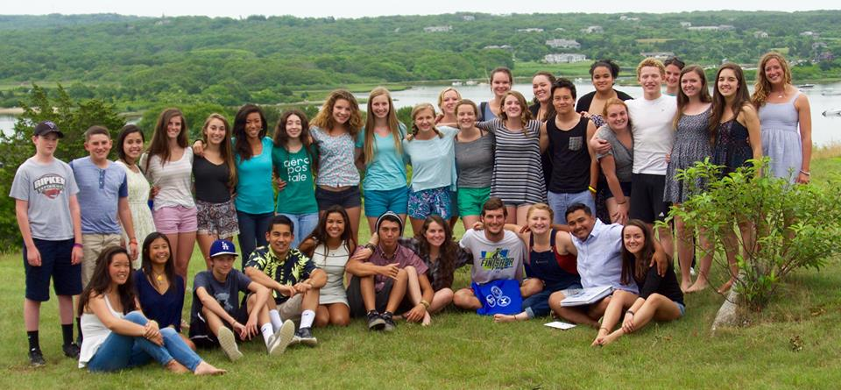
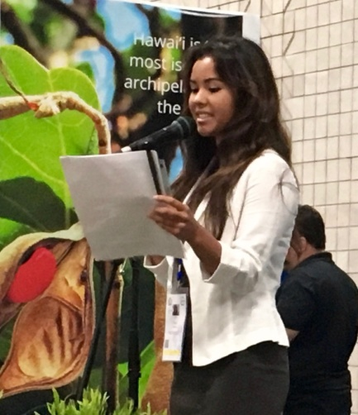
Our Vision
The TouchStone Leaders Platform igniting the humanitarian spirit within millennials with empowering tools for building a sustainable planet.

Slide 3
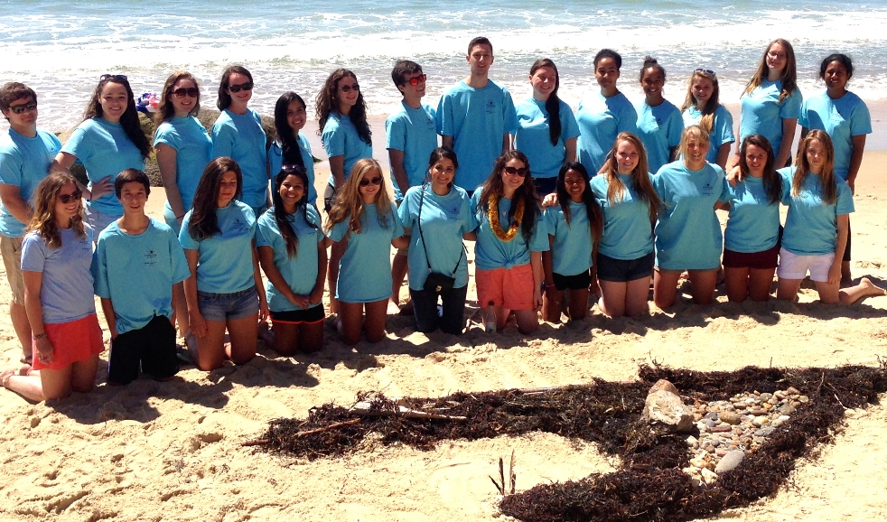
The Institute
The content and methodologies of the TouchStone Leaders Platform are based on The Stone Soup Institute’s 20 years developing educational tools that train facilitators to be humanitarian leaders.

Slide 4
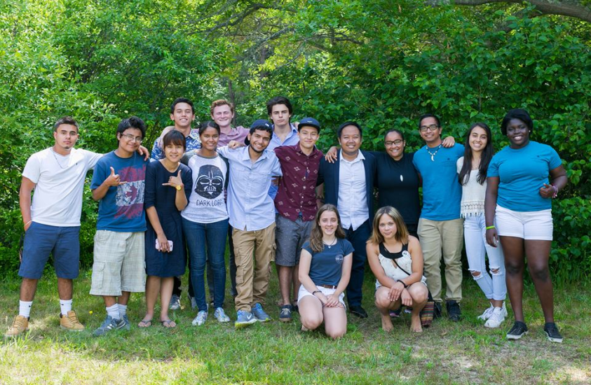
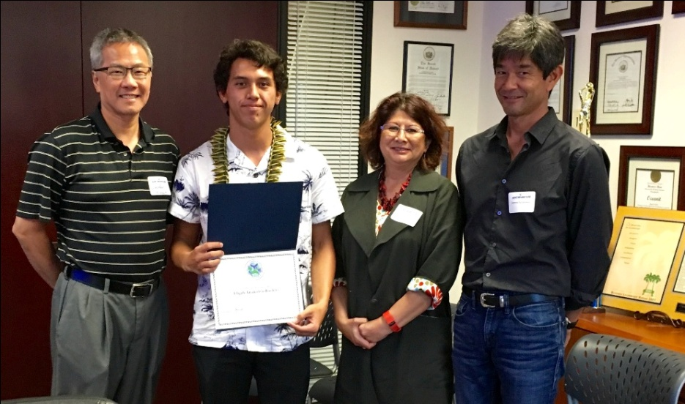
Nurturing Leaders
The TouchStone Leaders Platform bridges the gap between education and experience, nurtures millennials with a fun online community to have a positive impact on youth in their community.

Slide 5
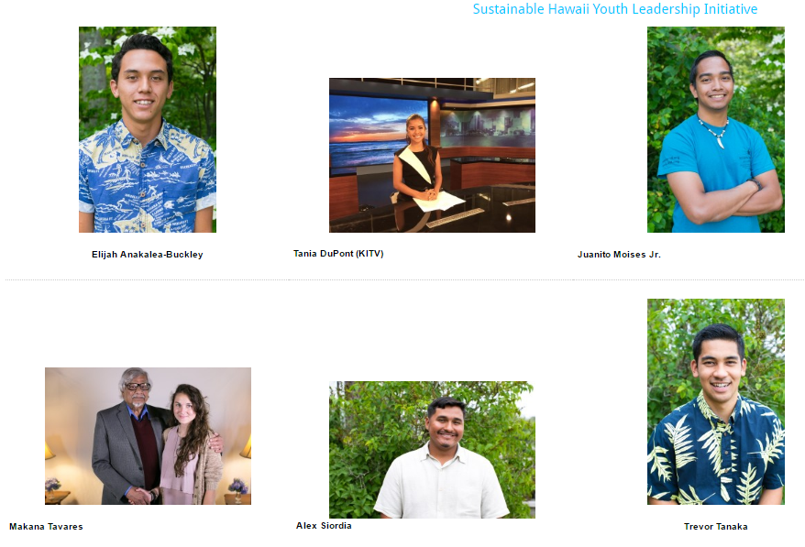

Slide 6
How It Works

Slide 7
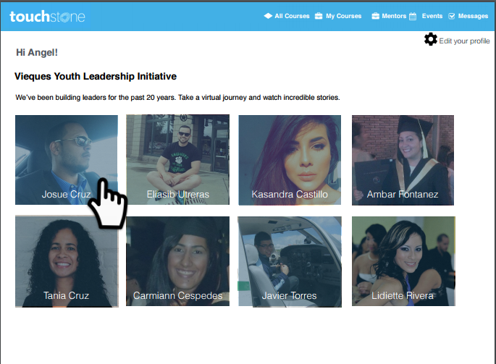
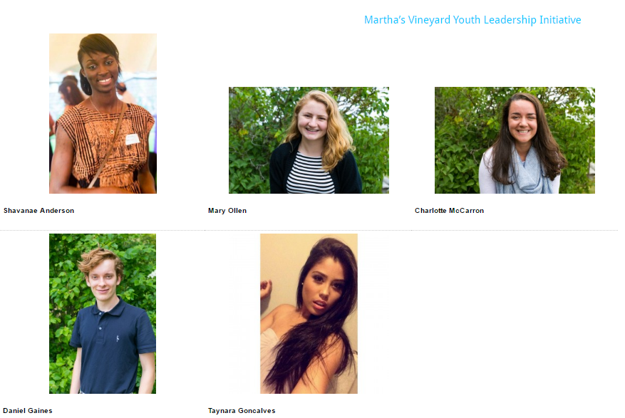
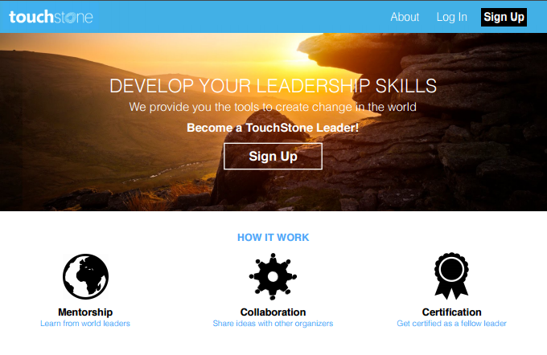

Slide 8
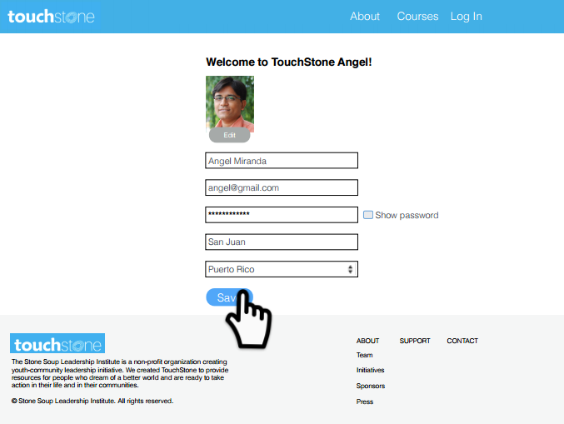

Slide 9
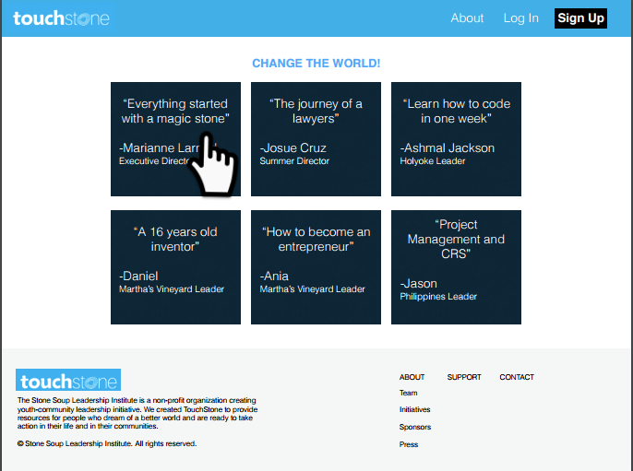

Slide 11
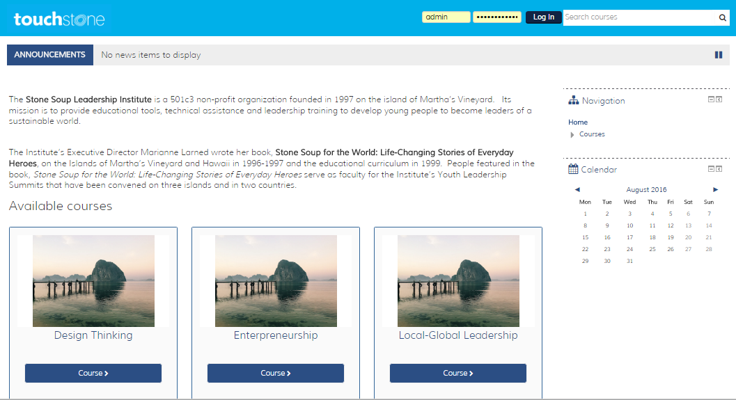

Slide 12
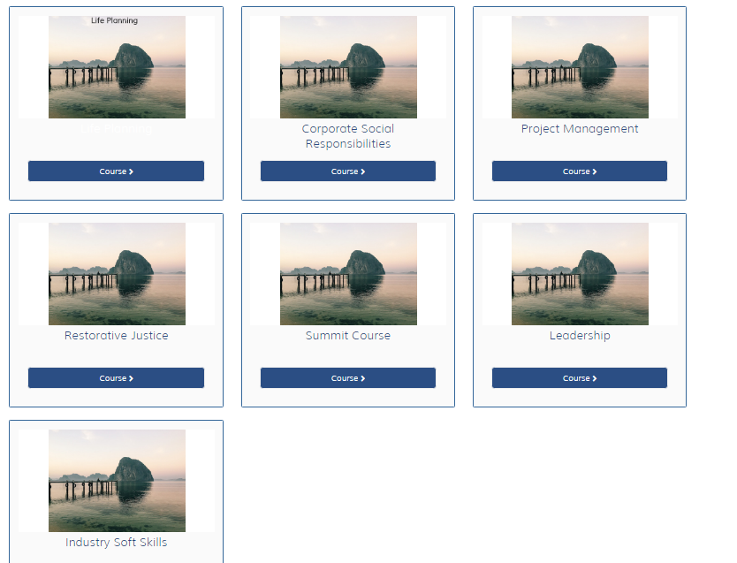

Slide 13
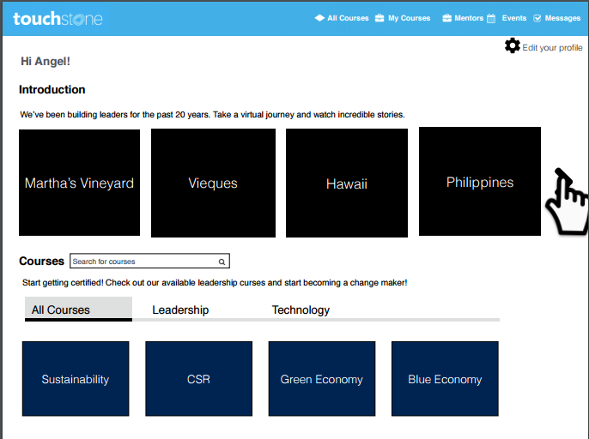

Slide 14
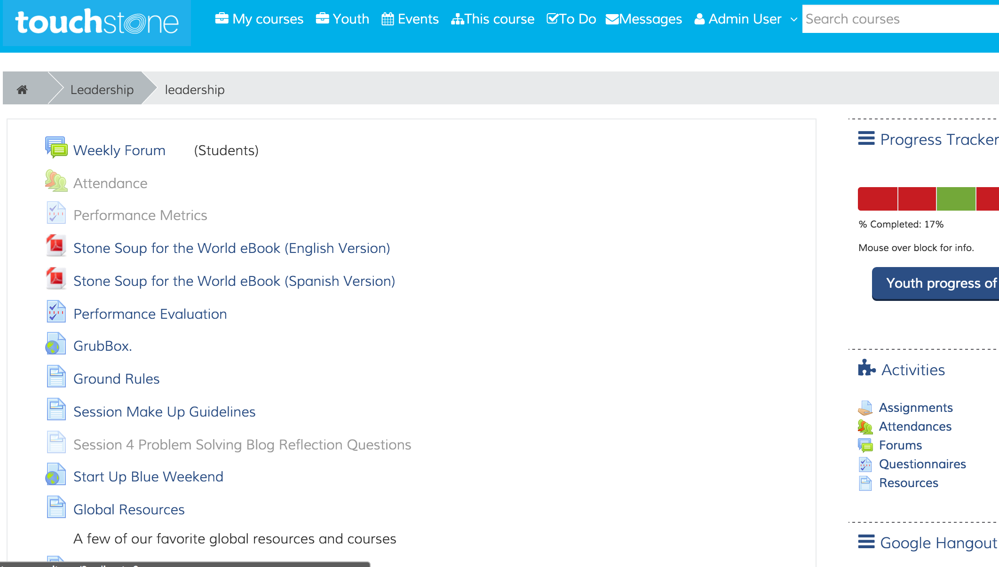

Slide 15
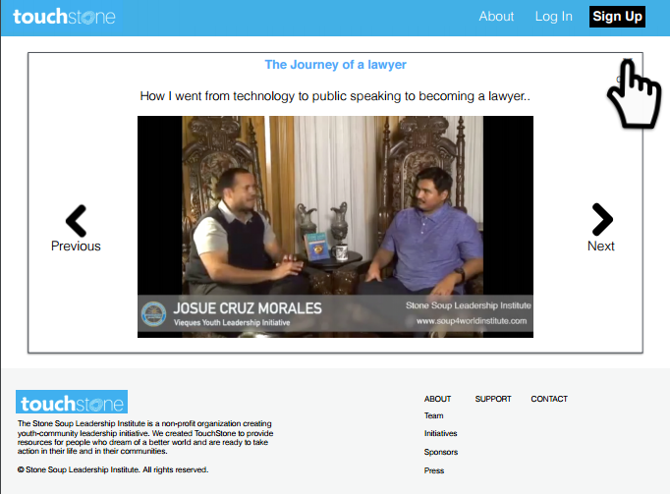

Slide 16
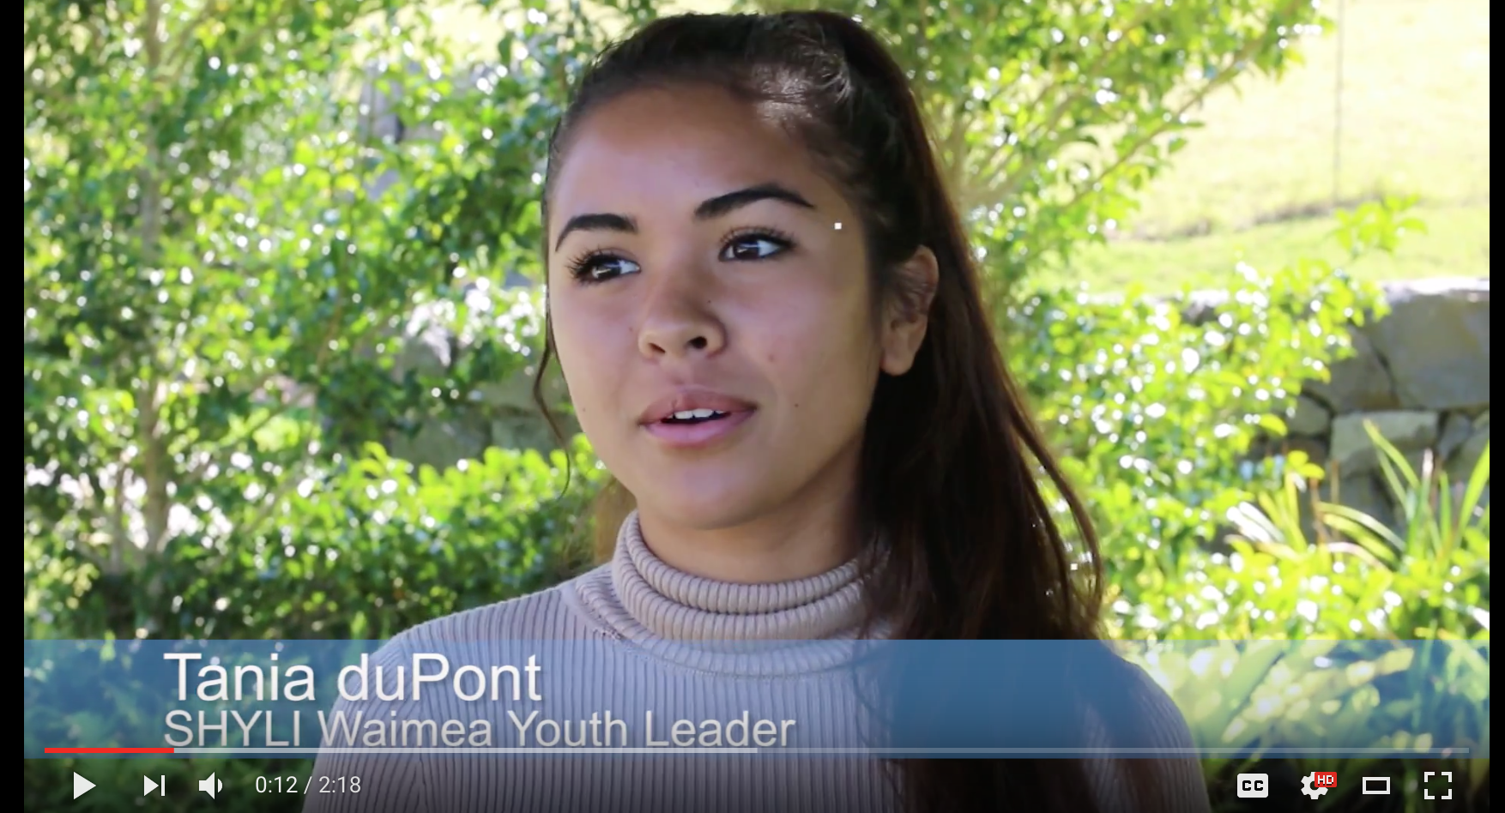

Slide 17
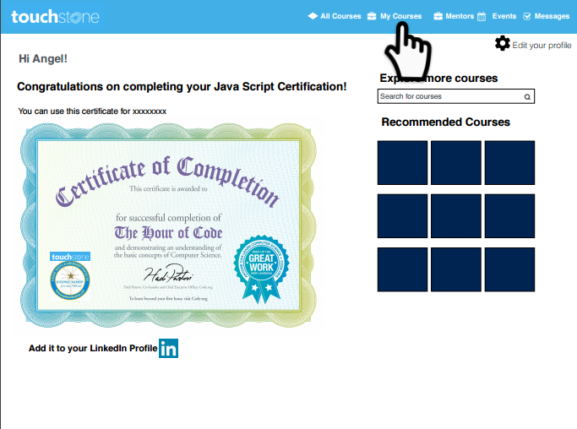

Slide 18
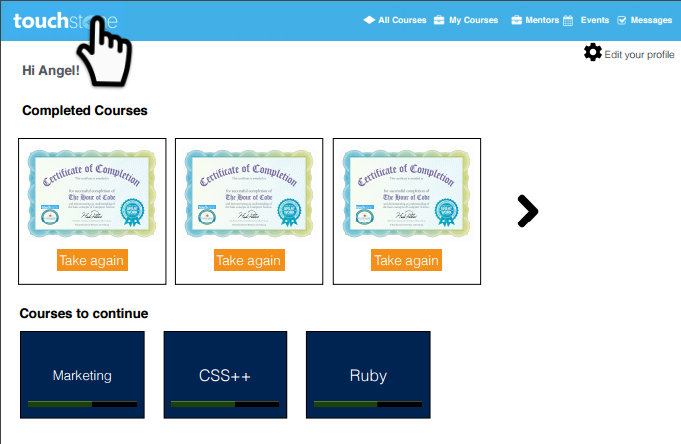

Slide 19
How You Can Support Us
For 2017-2018, the TouchStone LeadersPlatform’s acceleration costs are estimated at $715,000.
You can help us achieve our goals by:
Providing start-up capital
Partnering your local organization with us
Helping spread word
The Stone Soup Leadership Institute www.TouchStoneLeaders.com www.soup4worldinstitute.com

